Slide 1
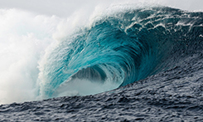
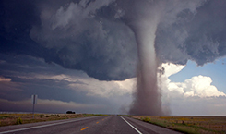
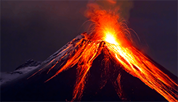
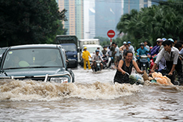
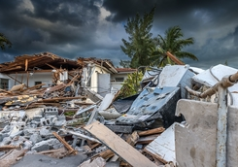
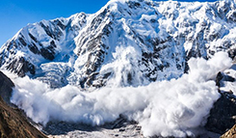
natural disasters

Slide 2
A tsunami
is a series of great sea waves caused by an underwater earthquake, landslide, or volcanic eruption.

Slide 3
Tornadoes
are vertical funnels of rapidly spinning air.

Slide 4
A volcano
is an opening in Earth’s crust that allows molten rock from beneath the crust to reach the surface.

Slide 5
A flood
is an overflow of water.

Slide 6
Avalanches
are masses of snow, ice, and rocks that fall rapidly down a mountainside.

Slide 7
An earthquake
is the shaking of the surface of the Earth.

Slide 8
natural disasters
An earthquake
is the shaking of the surface of the Earth
Avalanches
are masses of snow, ice, and rocks that fall rapidly down a mountainside.
A flood
is an overflow of water.
A tsunami
is a series of great sea waves caused by an underwater earthquake, landslide, or volcanic eruption.

Slide 9
natural disasters

